Slide 1
Network
Networks weave the fabric of our interconnected world

Slide 2
What is network !!

Slide 3
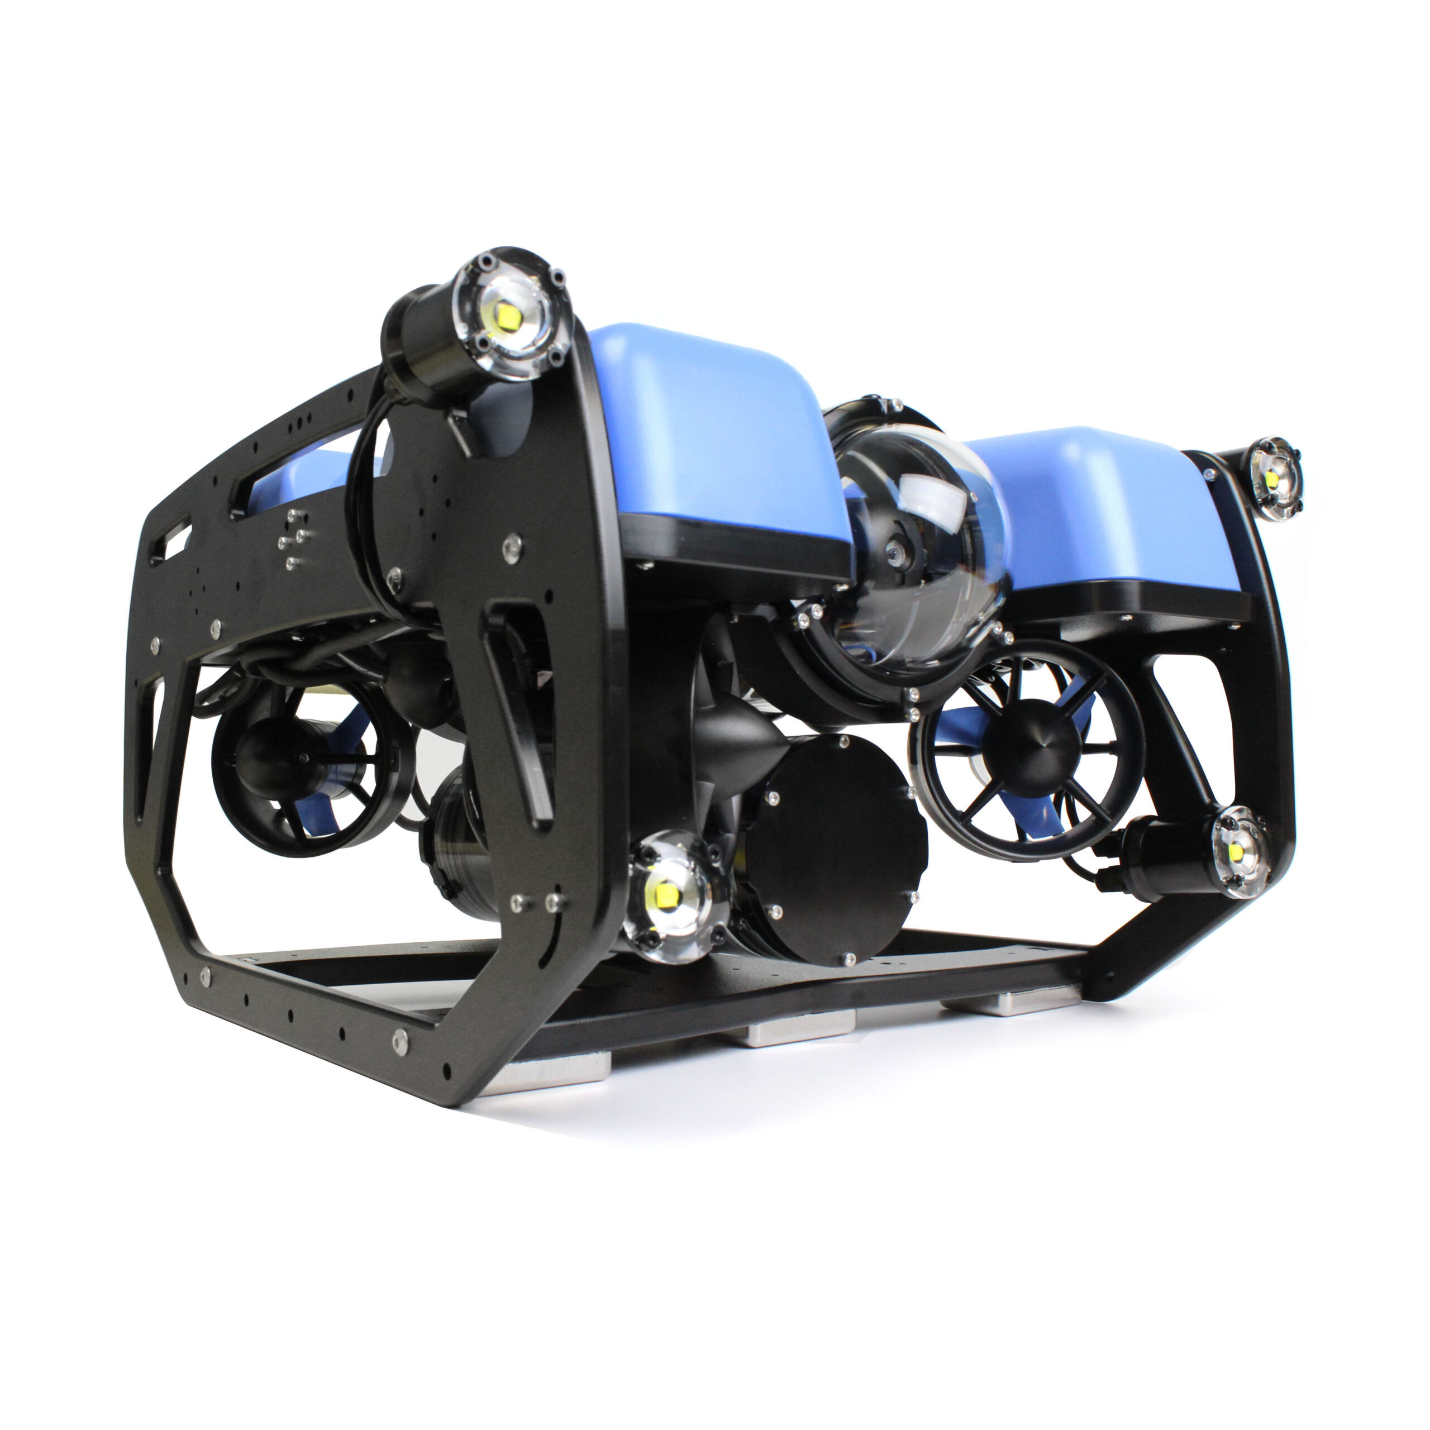
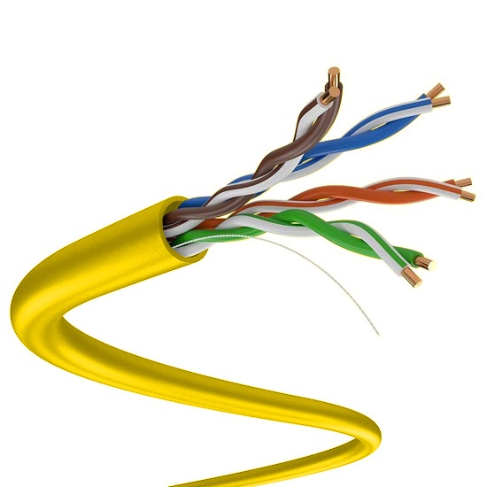

How could we communicate with the ROV ?
??!
Tether

Slide 4

Let’s build a network

Slide 5
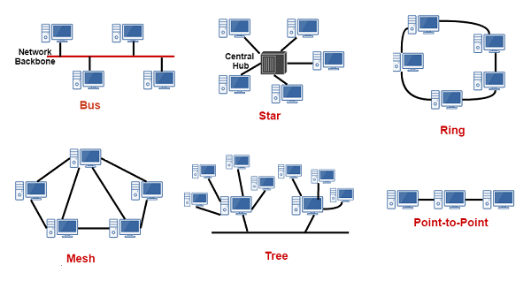
Network topology

Slide 6
How is the network formed?
Switch
Router
Switch
Router

Slide 7
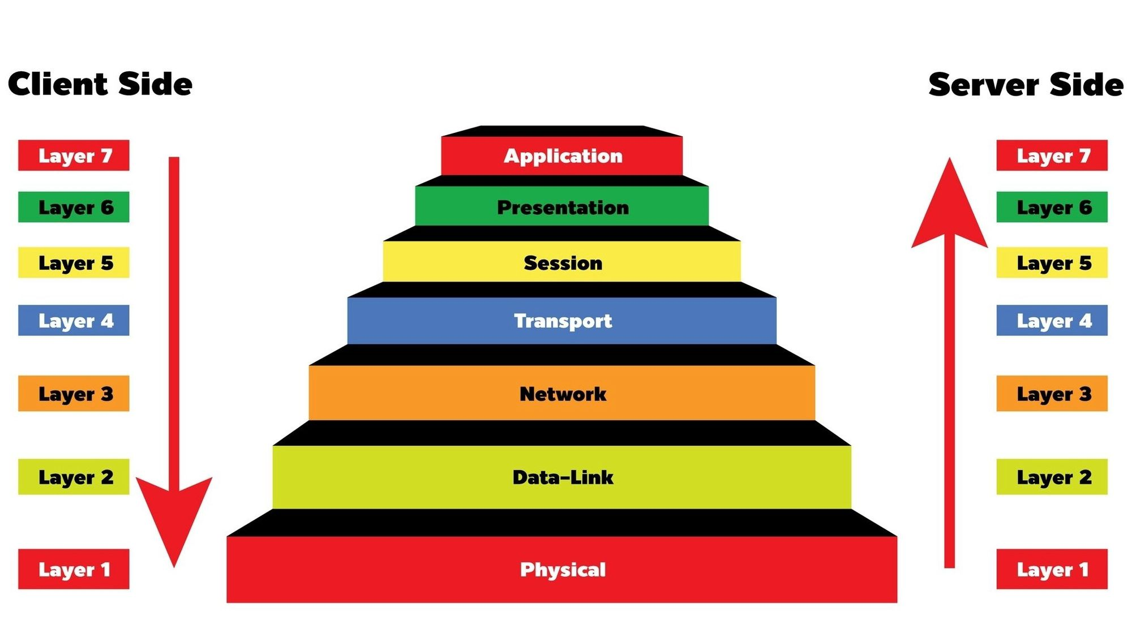
OSI layers

Slide 8
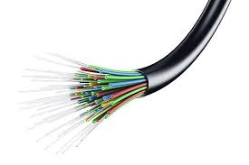
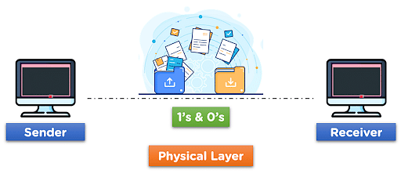
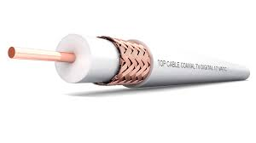
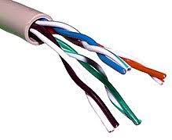

Physical layer

Slide 9
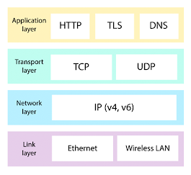
Network Protocols

Slide 10
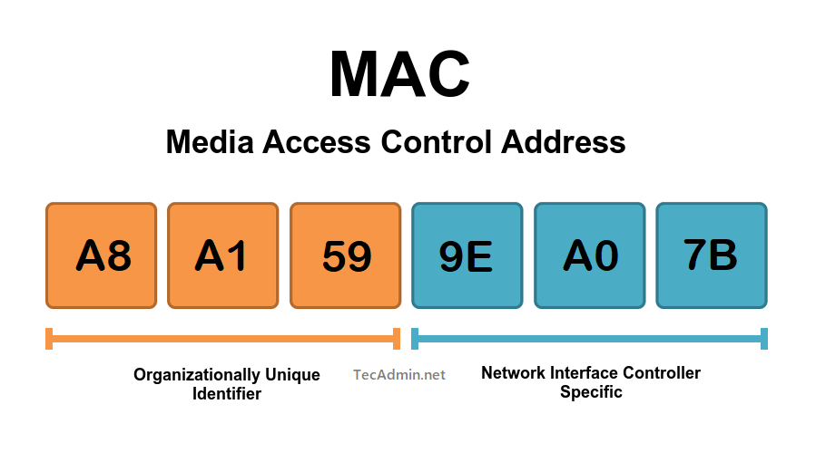
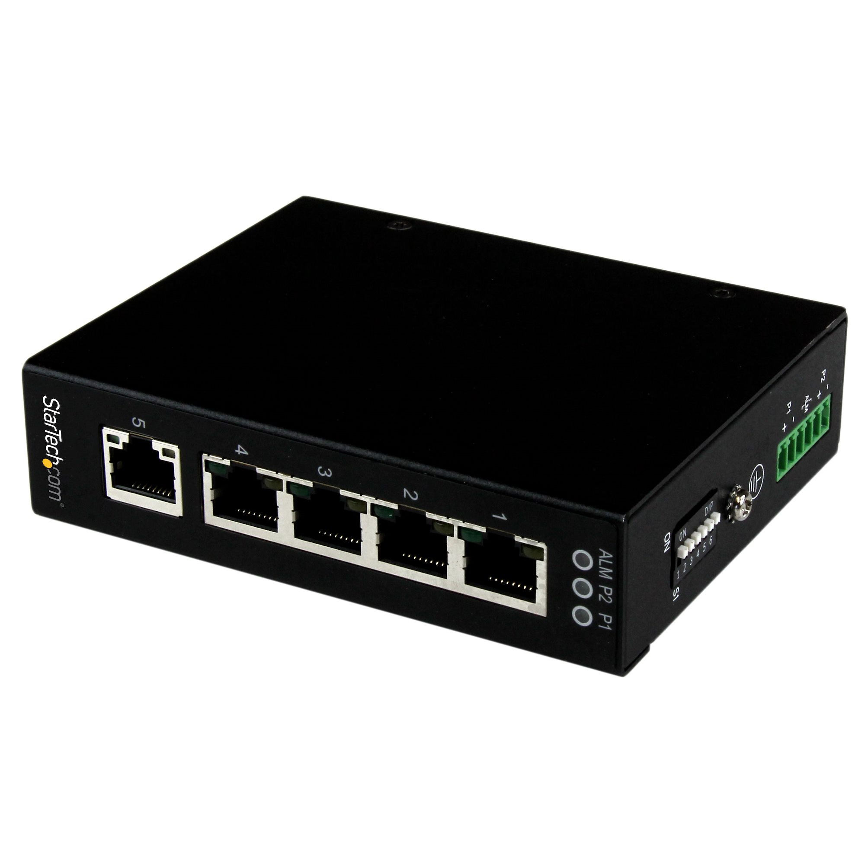
Data link layer

Slide 11


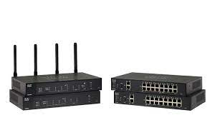
Network layer

Slide 12
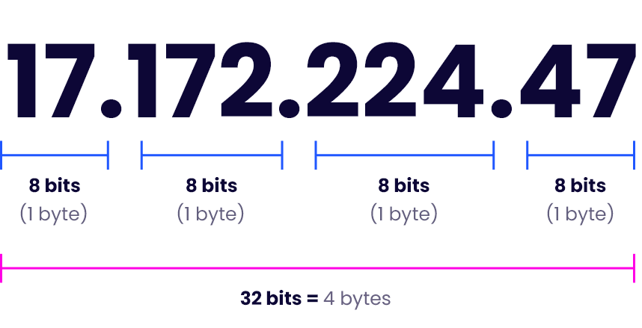
Internet Protocol “IP”

Slide 13
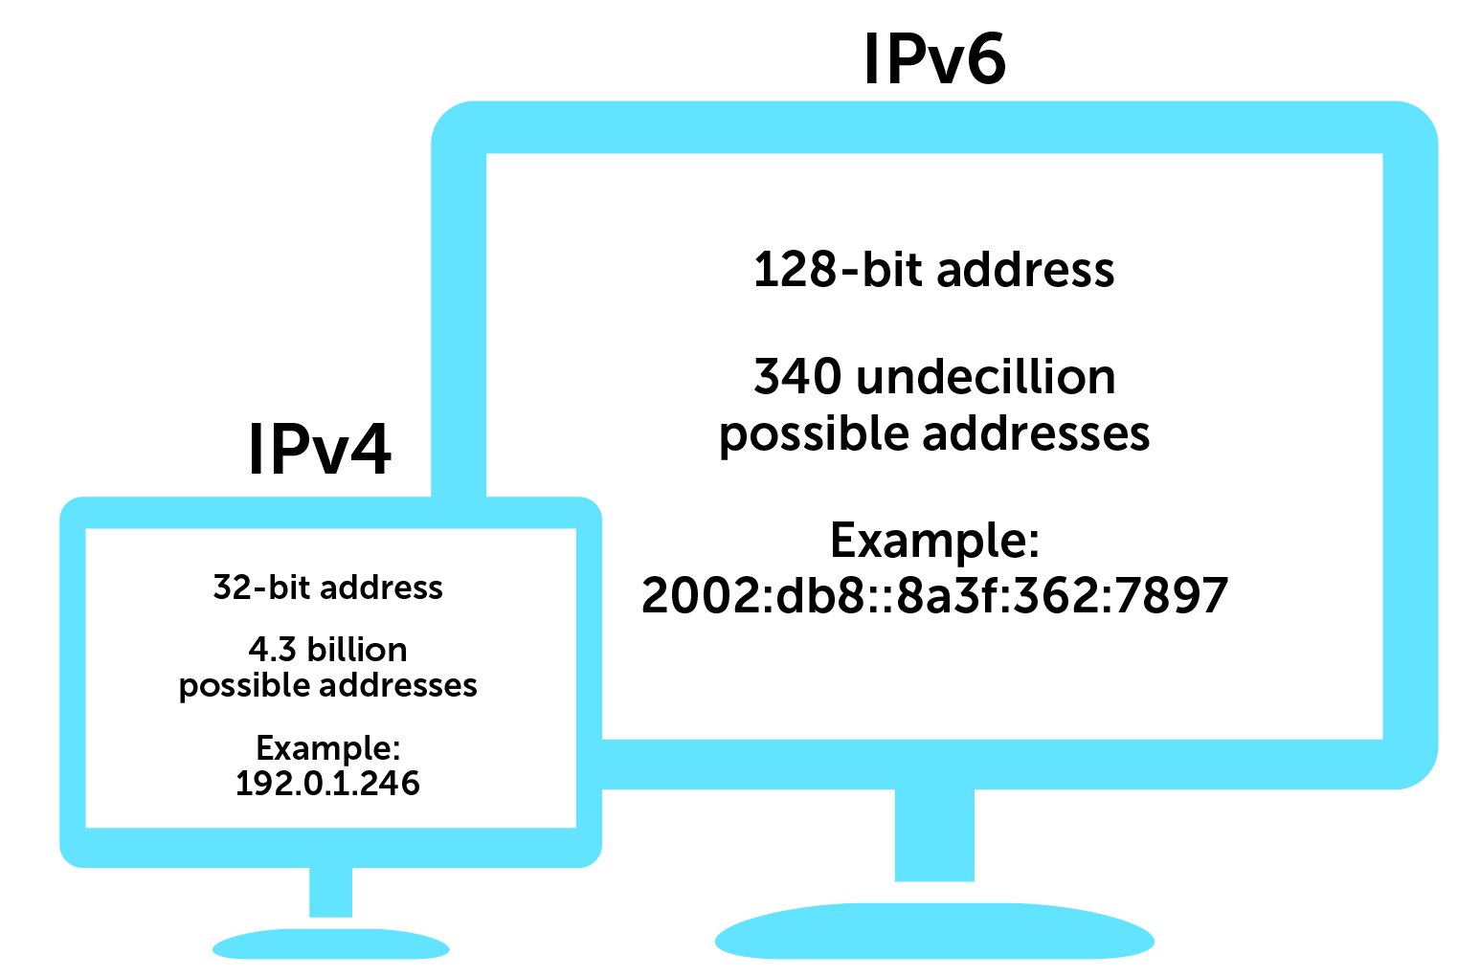
Internet Protocol “IP”

Slide 14
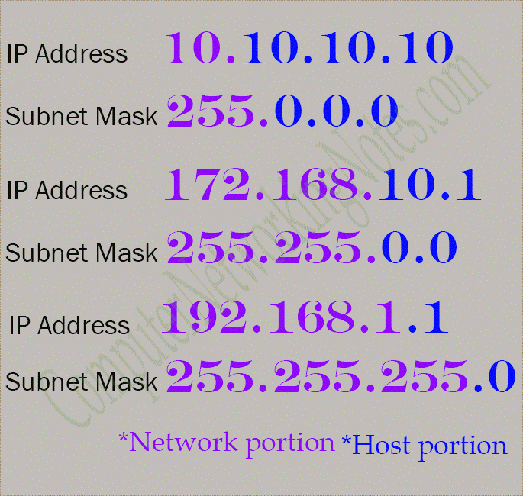
Subnet mask

Slide 15
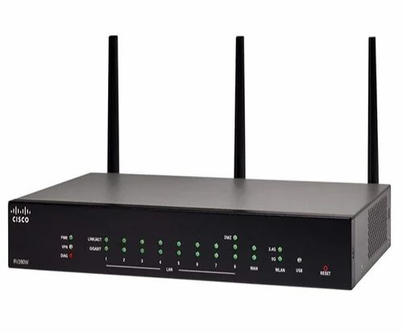
Router

Slide 16
Default gateway & Broadcast IP

Slide 17
DHCP

Slide 18
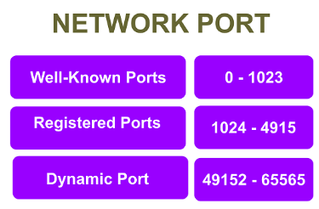
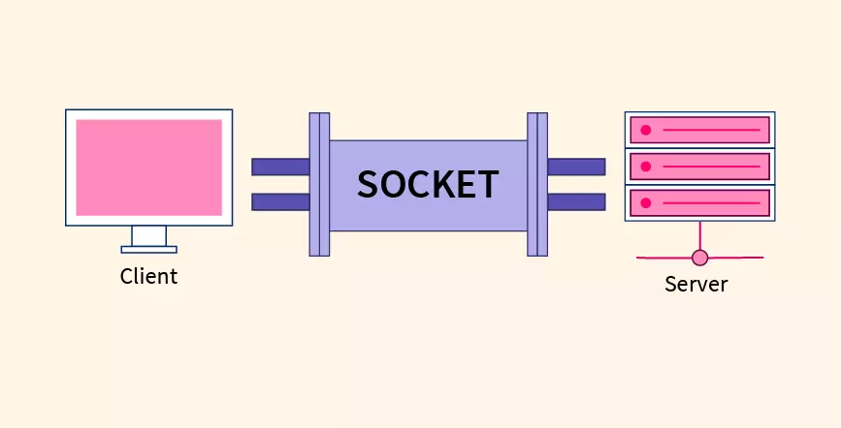
Transport layer

Slide 19


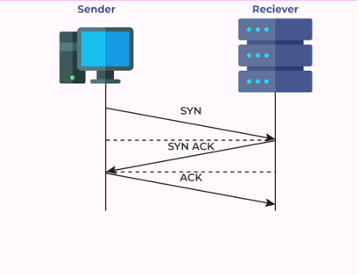
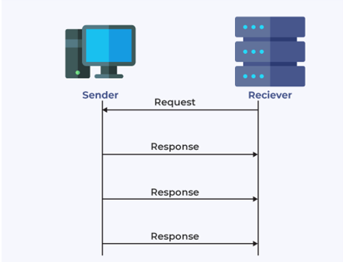
TCP/UDP Protocols

Slide 20
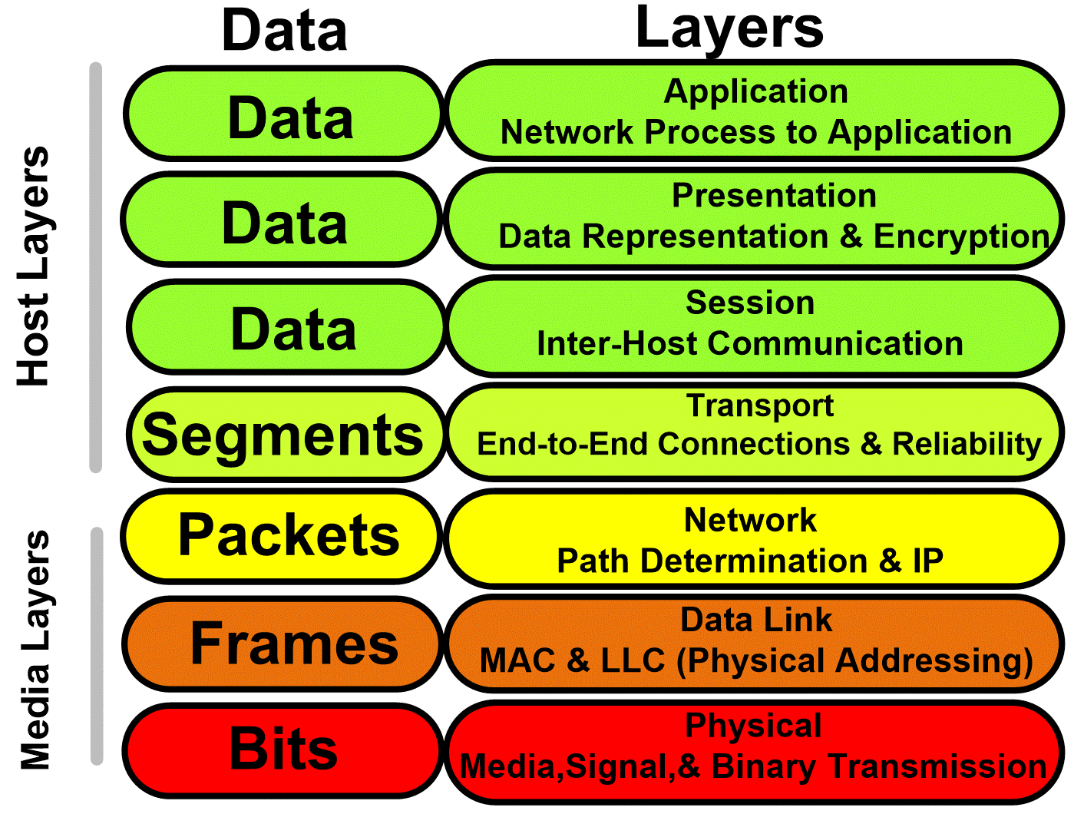
Data Encapsulation

Slide 21
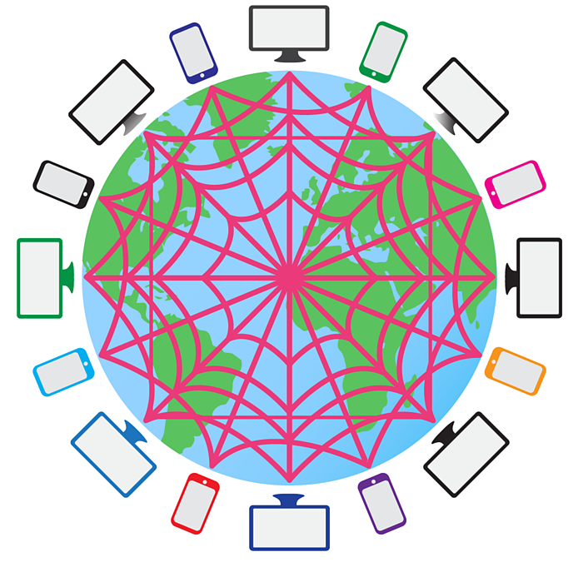
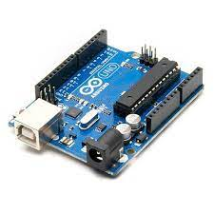

Micro controllers as Network a teminal

Slide 22
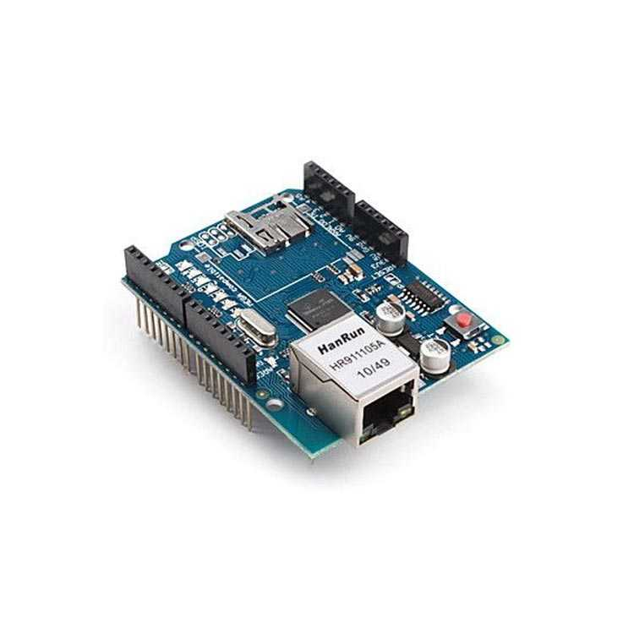
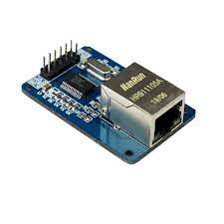
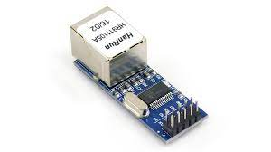
Ethernet Modules

Slide 23
Time for Workshop

Slide 24
How to write a communication code?
Python sockets
Arduino UIPEthernet

Slide 25
Time for Workshop

Slide 26
Resources
https://youtube.com/playlist?list=PLH-n8YK76vIiuIZoWvHL7AvtrDV7hR3He
https://youtube.com/playlist?list=PLH-n8YK76vIiDdOMRB-ylvns-_8Zl1euV
https://youtube.com/playlist?list=PLoP_aS_FoPQfCHLDULY7wmjz3Qgp5f7il
https://youtube.com/playlist?list=PLS1QulWo1RIZGSgRsn0b8w9uoWM1gHDpo

